Slide 1
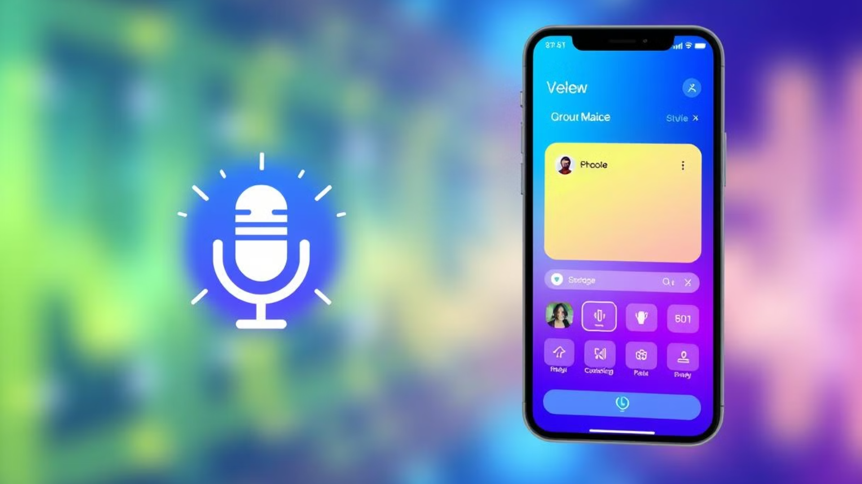


Voice-Based Form Filling Application
A seamless and accessible approach to form filling

Slide 2
Project Overview
Concept
Implementation
This application utilizes the Web Speech API to enable users to fill out forms by speaking instead of typing.
Built with a Flask backend for API handling and MySQL for data storage, ensuring efficient and secure data management.

Slide 3

Motivation
Accessibility
Convenience
Provides a user-friendly experience for individuals with disabilities, allowing them to engage with online forms effortlessly.
Offers a hands-free approach, making form filling faster and more convenient, especially on the go.
Efficiency
Streamlines data entry, reducing the time and effort required to complete online forms.

Slide 4
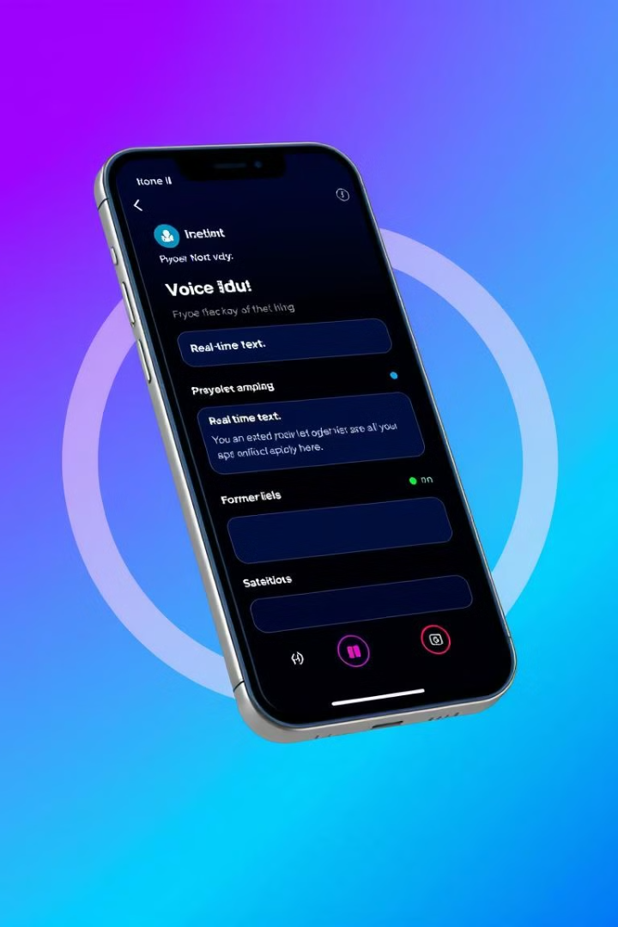




Key Features
Voice Input
Real-Time Speech-to-Text
Users can simply speak their responses, allowing for natural and intuitive form filling.
The application converts spoken words into text in real-time, providing instant feedback to users.
Multi-Field Support
Clean, User-Friendly UI
Handles various form field types, including name, email, phone number, address, and more.
Designed for ease of use and navigability, ensuring a smooth and enjoyable user experience.

Slide 5
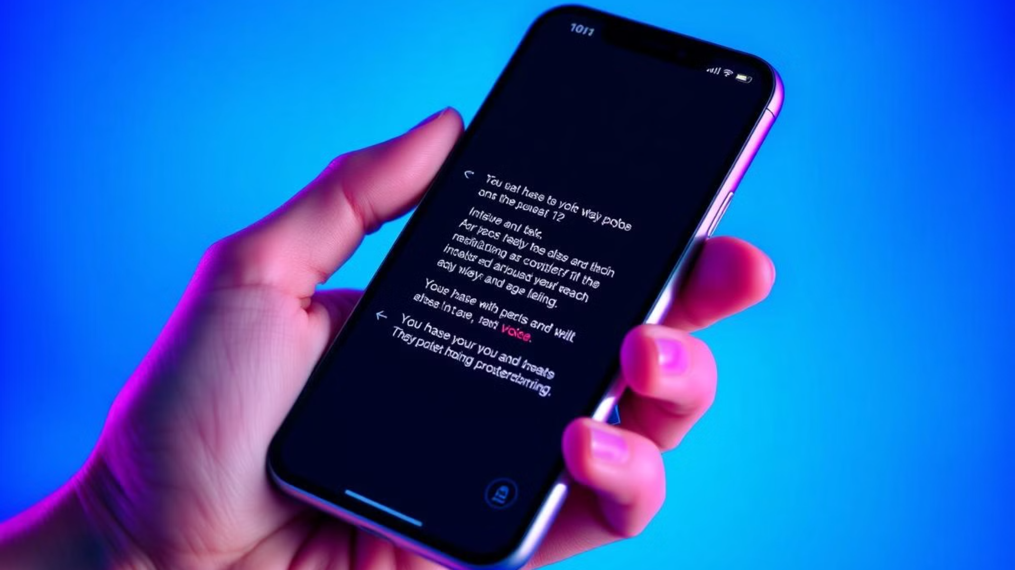
Voice Input and Speech-to-Text
Capture
Display
The app utilizes the Web Speech API to capture voice input from users.
The transcribed text is displayed in real-time on the screen, allowing users to verify their input.
1
2
3
Process
The captured audio is then processed by a speech-to-text engine to convert it into written text.

Slide 6
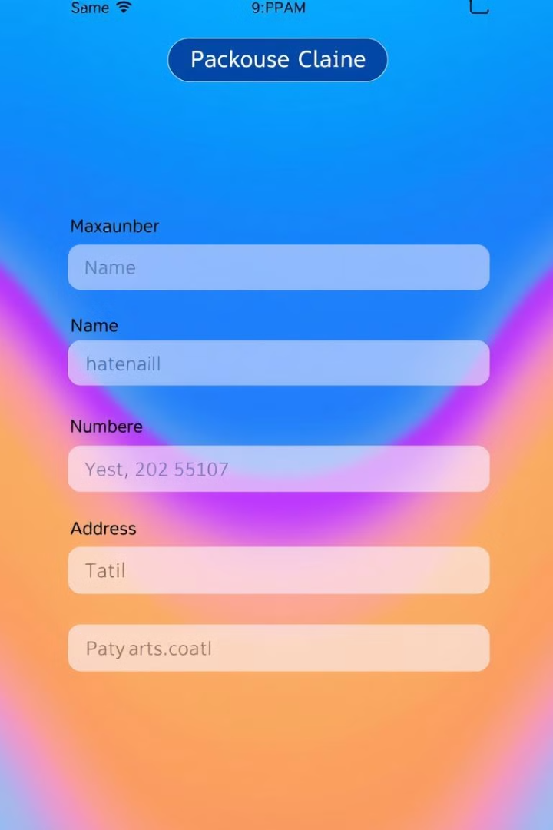
Multi-Field Support
Name
Email
Capture user's full name by speaking, ensuring accuracy with auto-correction features.
Allows users to dictate their email addresses, verifying the format for proper input.
Phone Number
Address
Facilitates quick and easy entry of phone numbers, ensuring correct formatting and area codes.
Enables users to speak their complete addresses, simplifying the input process.

Slide 7




User-Friendly Interface
Intuitive Layout
The app features a clean and straightforward layout, making it easy to understand and navigate.
Clear Instructions
Simple and concise instructions guide users through the form filling process.
Visual Feedback
Real-time text display and progress indicators provide constant visual feedback to users.
Accessibility Features
Includes accessibility features like screen reader compatibility and customizable text sizes.

Slide 8




Technology Stack
Web Speech API
1
Enables voice input and real-time speech-to-text processing.
Flask
2
Provides a robust backend framework for API handling.
MySQL
3
Offers a reliable database system for secure data storage.
UI Libraries
4
Handles the design and user interface elements of the application.

